Slide 1
UA ASCEND!
2014 Space Grant Symposium
Saturday, April 12th
University of Arizona

Slide 2




Acknowledgments

Slide 3

Outline
Problem
Objective
Method
Results
Conclusion

Slide 4
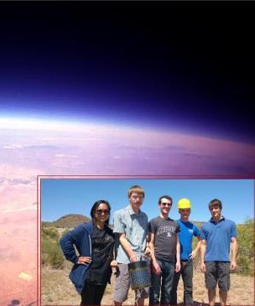
The Team
Eric Moser
Andrew Siemens
Ryan Stelzer
Amanda Urquiza
Alex Yudkovitz

Slide 5
The Problem
Currently, the world is experiencing an energy crisis.
Demand for energy continuously increases, as the supply of non-renewable resources depletes.
Space Based Solar Power (SBSP) harvests solar energy in space and wirelessly transfers it back to Earth.
Notes:
http://www.nss.org/settlement/ssp/

Slide 6
Objective
Study the efficiency of solar panels at high altitudes
Hypothesis - As solar panels rise in altitude, they become more efficient as atmosphere thins
Fall 2013 - Determine if efficiency is greater at higher altitudes
Spring 2014 - Determine what affects solar panel efficiency at different altitudes

Slide 7
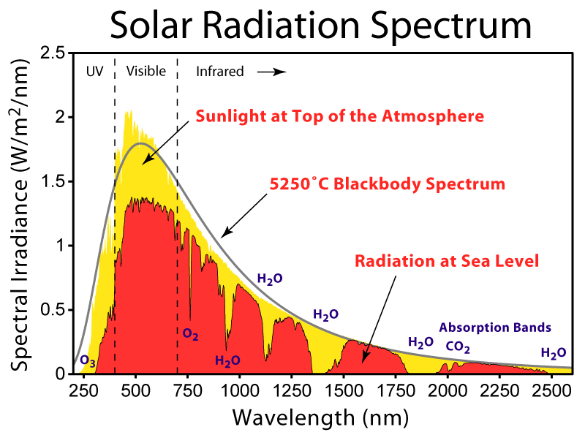

Slide 8
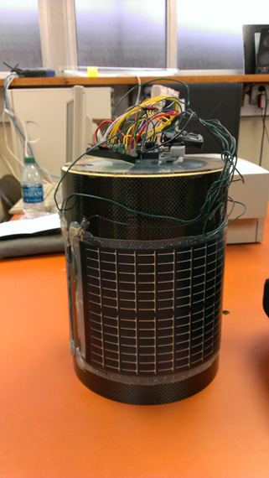
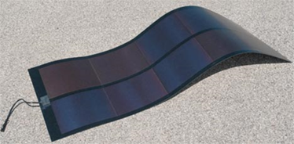
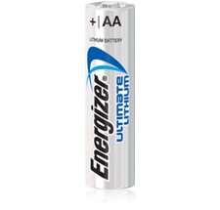
Experiment
  Sample Output:
  Time 00:00:45
  x: 0 y: 0 z: 1.0 (g)
  altitude: 600 (m)
  voltage: 1.5 (v)
  b-field: x: 0 y: 0 z: 0

Slide 9
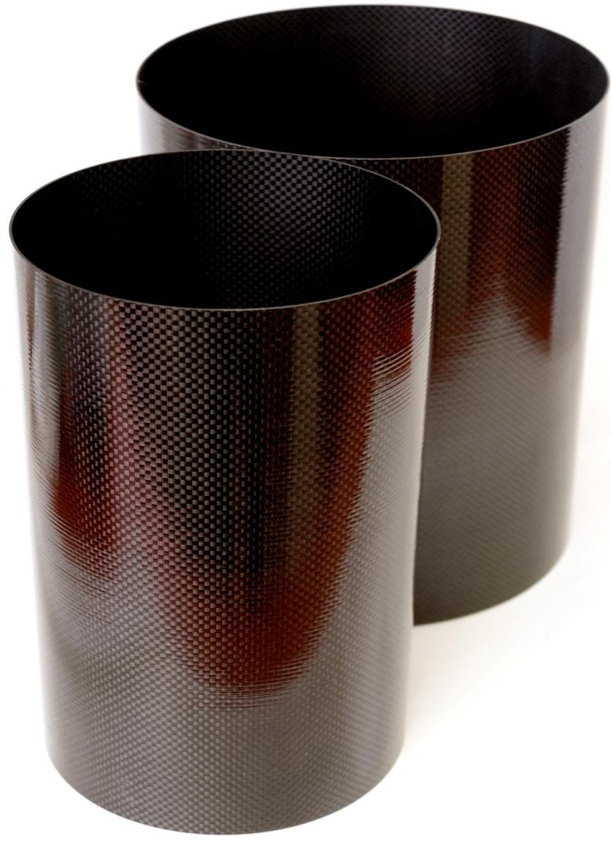
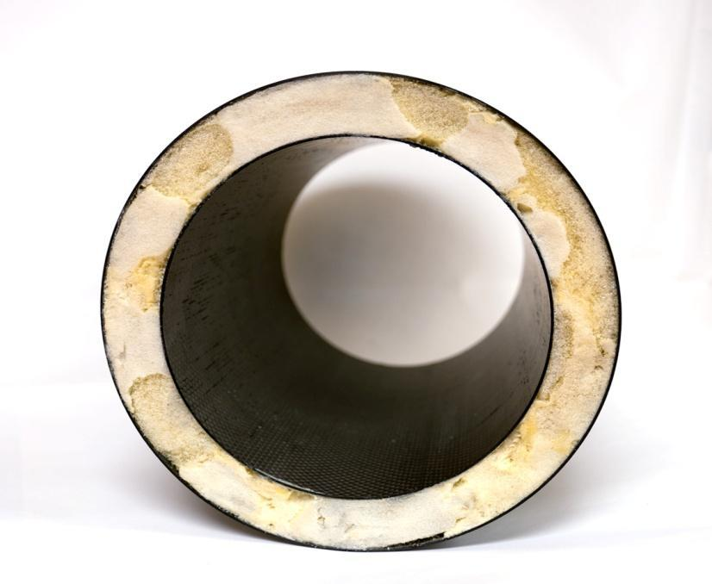
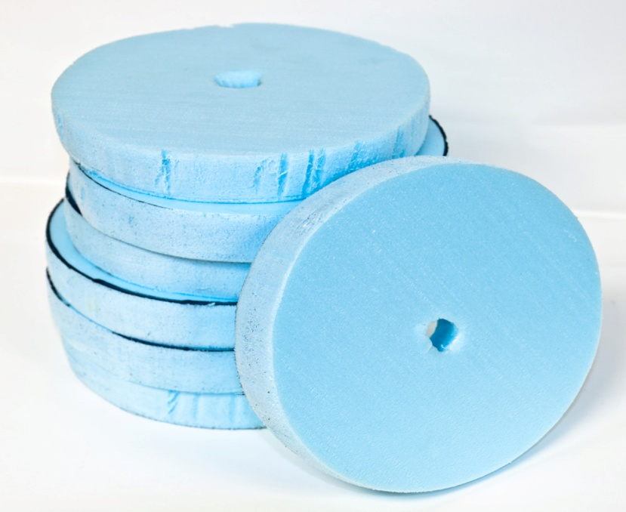
Payload Shell
Two carbon fiber cylinders
  Smaller cylinder nested inside large cylinder
Two-part liquid foam
  When mixed, solidifies into foam and expands
  2 lbs per cubic foot
Lexan Polycarbonate
  Used to cap the top and bottom of payload

Slide 10
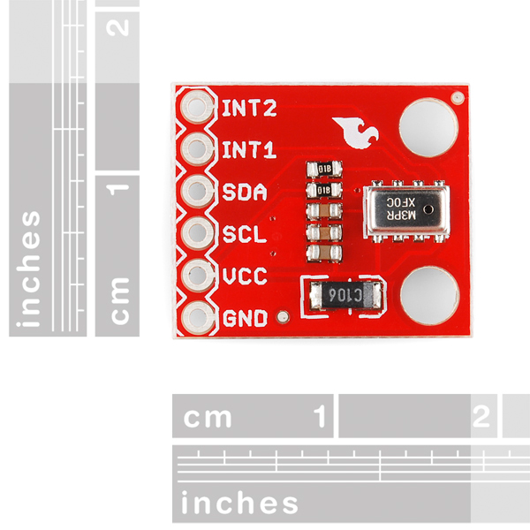
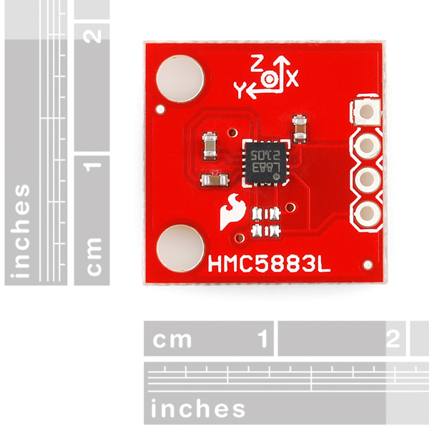
Electronics
Altitude/Pressure Sensor Breakout - MPL3115A2
Triple Axis Magnetometer Breakout - HMC5883L

Slide 11
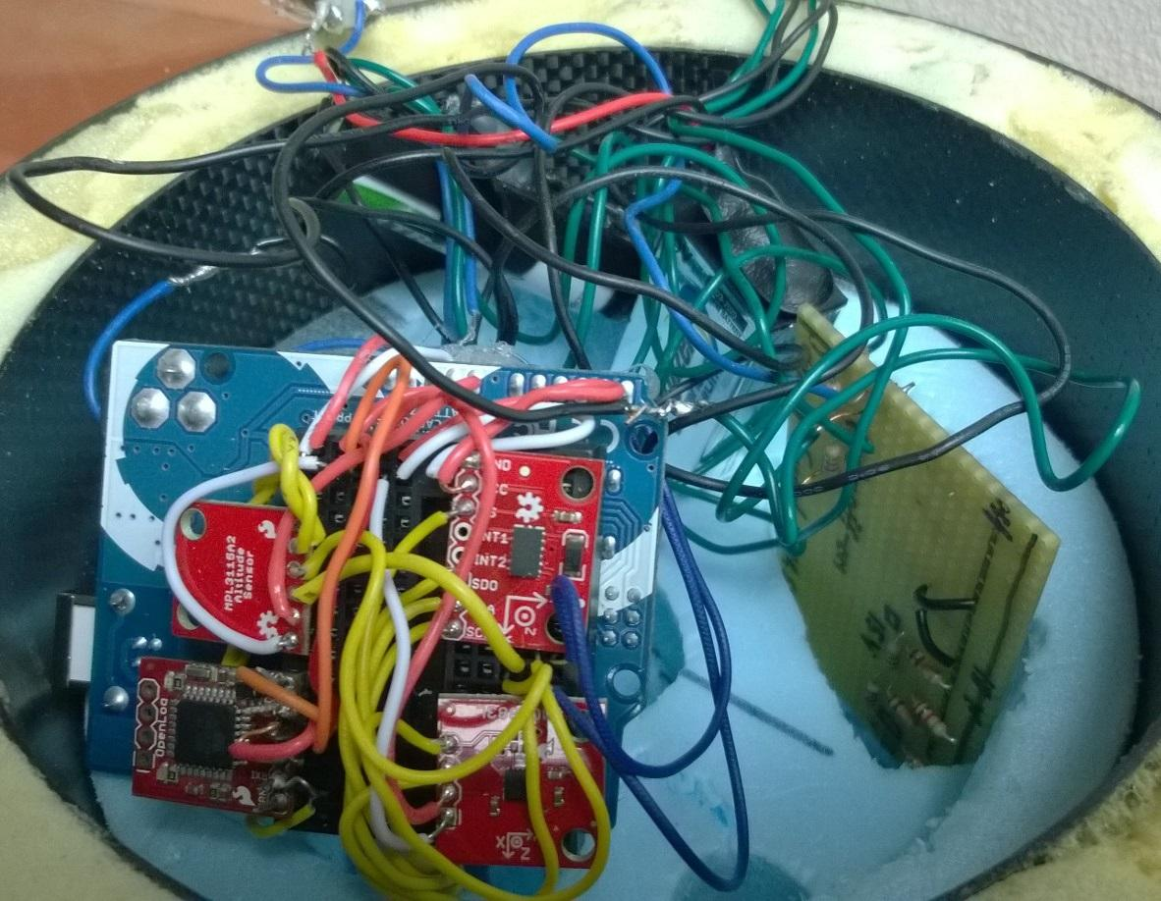
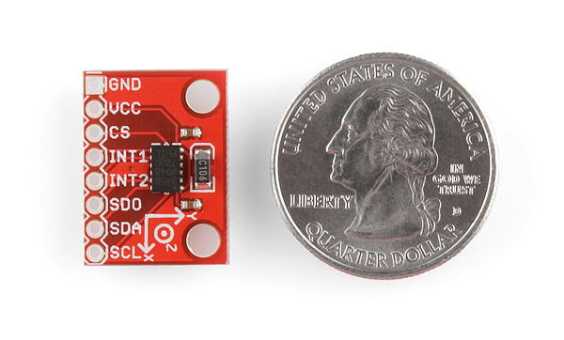
Electronics
Triple Axis Accelerometer Breakout - ADXL345

Slide 12
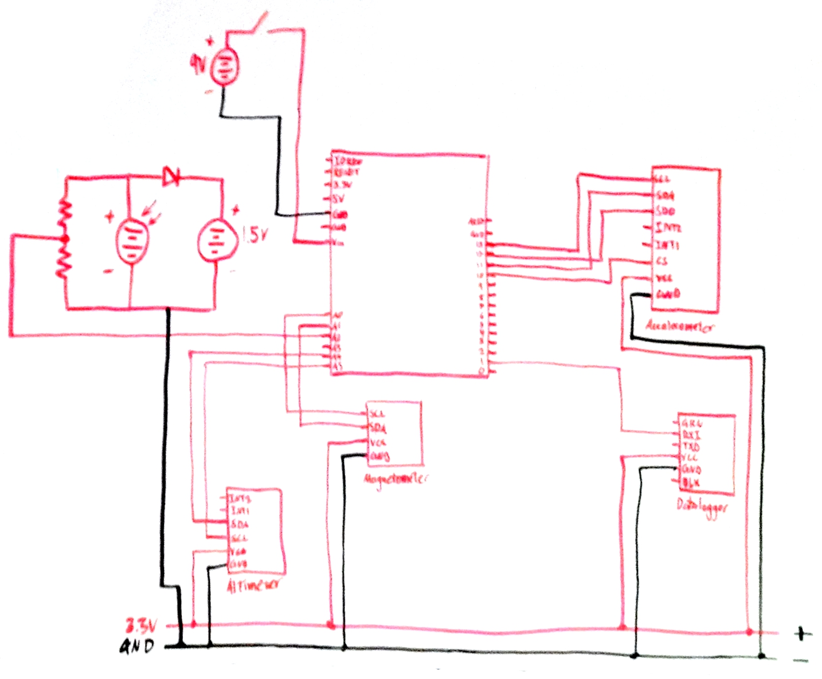
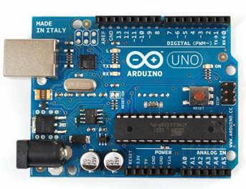

Electronics
Arduino UNO microprocessor
Powered by a 9V battery

Slide 13
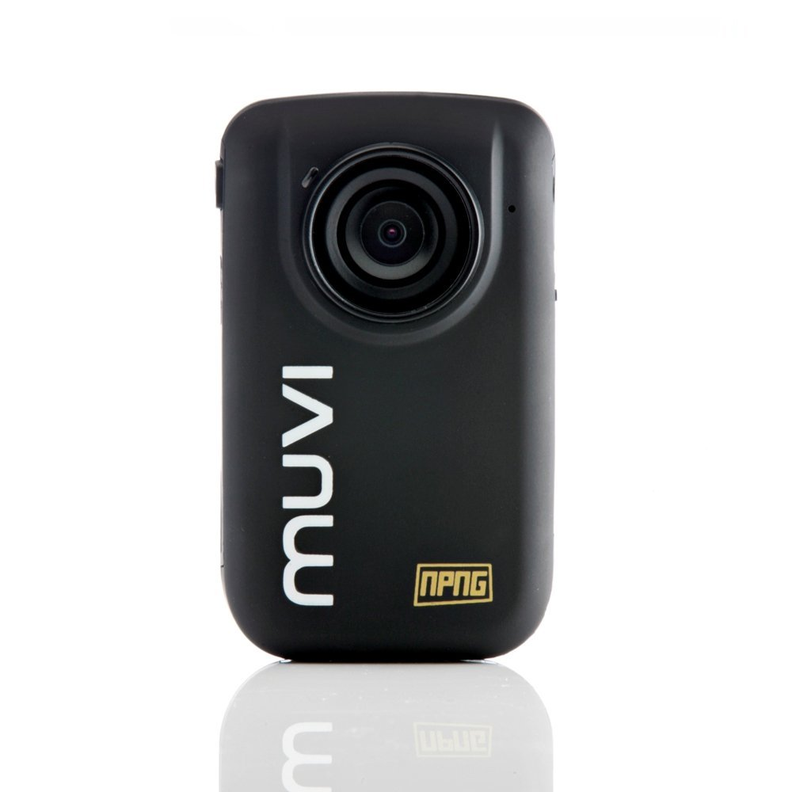
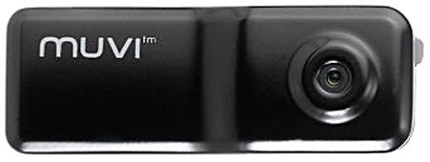
MUVI Camera
Veho MUVI Micro Action
72 degree angle lens
2MP image resolution
4GB memory
Veho MUVI HD ActionCam
170 degree wide angle lens
5MP HD video resolution
8GB memory
Notes:
Also mention: orientation of cameras

Slide 14
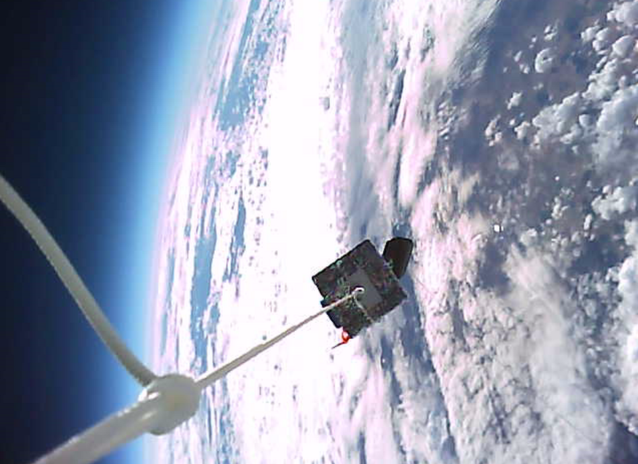
MUVI MicroAction

Slide 15
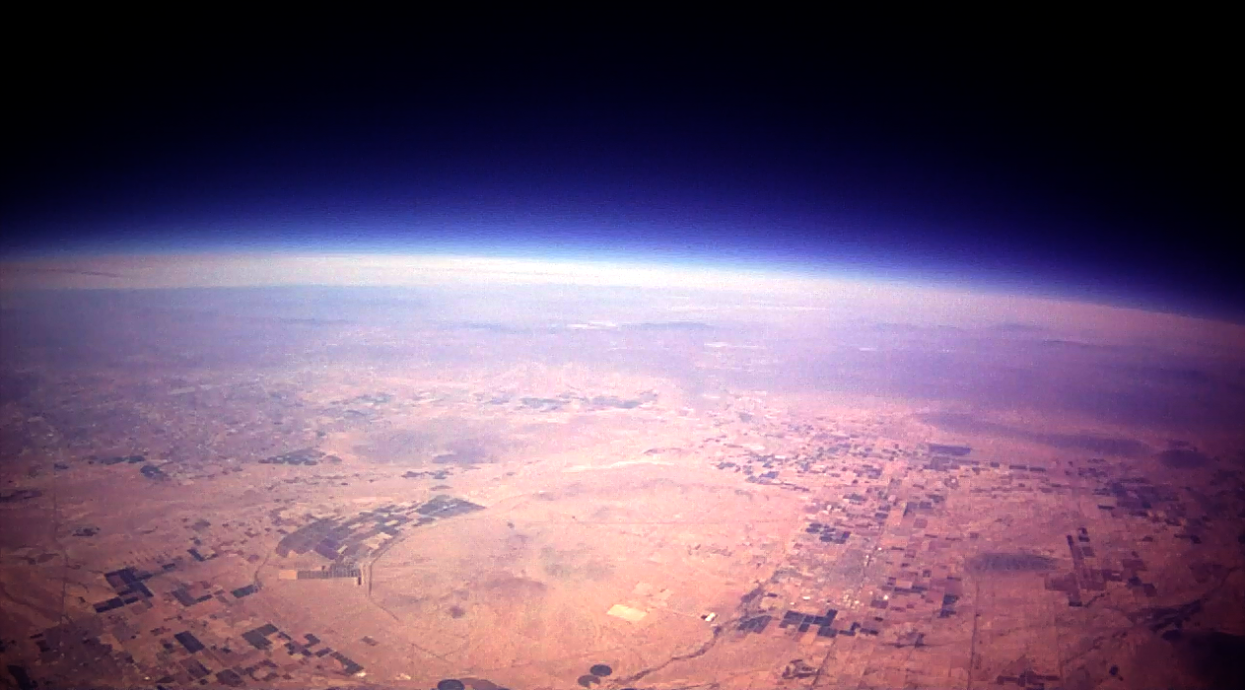
MUVI ActionCam

Slide 16
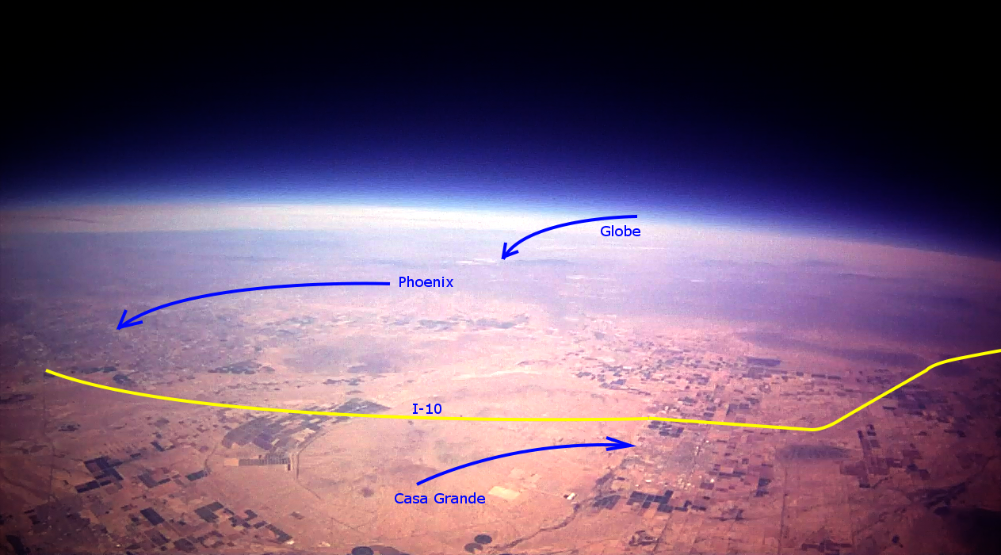
MUVI ActionCam

Slide 17
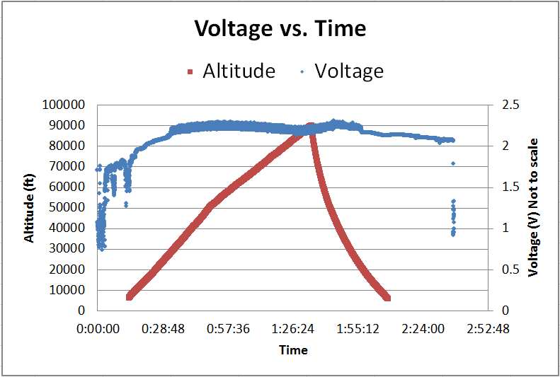
Fall Results
Altitude from ANSR data
Notes:
Altitude did not work

Slide 18
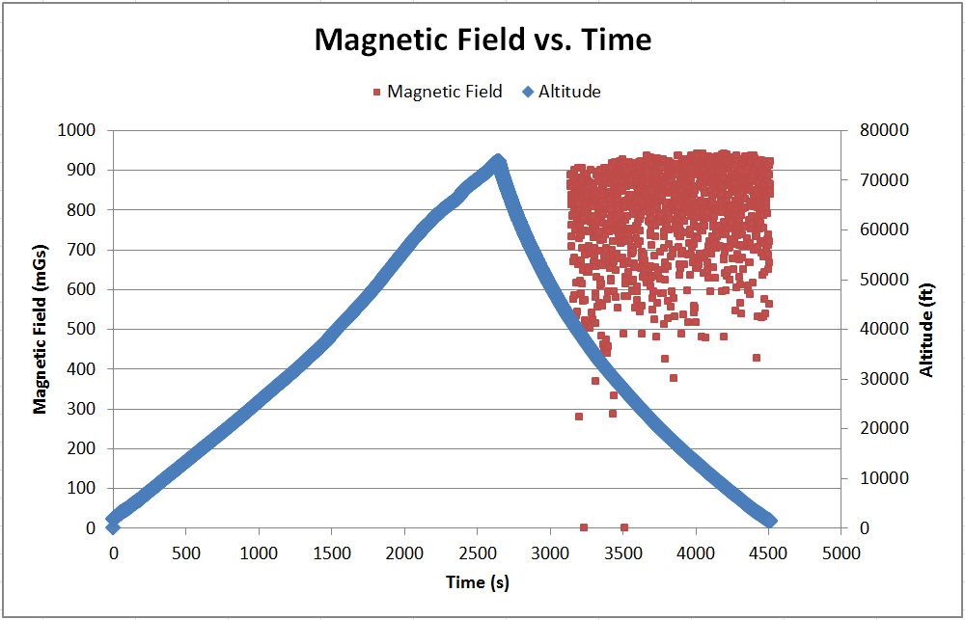
Spring Results
Altitude from ANSR data
Notes:
Only got chunks of data, Altitude worked but was scaled slightly off of the ANSR data, Voltage was at 10 the whole time but dropped off at end,

Slide 19
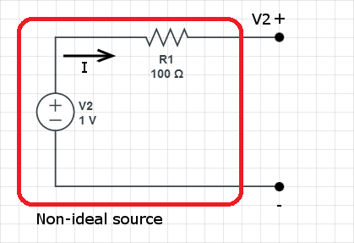
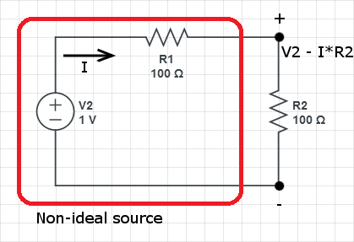
Loading Effect
Solar panel voltage is “ideal” under no load
Adding load reduces voltage across solar panel
  Power is used by load
Voltage can be brought back up with higher altitude
Loading effect is counteracted at higher altitude

Slide 20
Conclusion
Confirmed that solar panels are more efficient at higher altitudes
Solar panels maxed out during the flights and the voltage stopped rising
Successfully captured video of entire flight
Participated in outreach with TV show The STEM Journals

Slide 21
Bibliography
2011-2014. Photograph. Karlsson Robotics Web. 2 Apr 2014.
<http://www.karlssonrobotics.com/cart/triple-axis-accelerometer-breakout-adxl345/>.
2011-2014. Photograph. Karlsson Robotics Web. 2 Apr 2014.
<http://www.karlssonrobotics.com/cart/triple-axis-magnetometer-breakout-hmc5883l/>.
2011-2014. Photograph. Karlsson Robotics Web. 2 Apr 2014.
<http://www.karlssonrobotics.com/cart/MPL3115A2-Altitude-Pressure-Sensor-Breakout/>.
"Space Solar Power." National Space Society. National Space Society,
21 Mar 2014. Web. 2 Apr 2014. <http://www.nss.org/settlement/ssp/>.

Slide 22
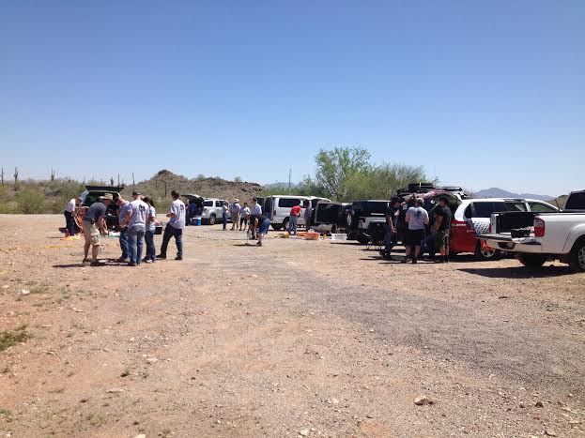
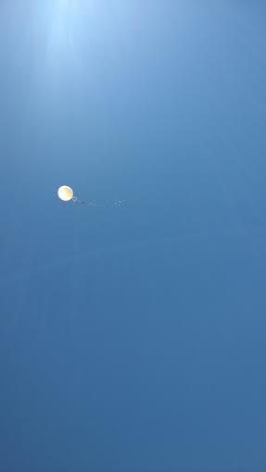
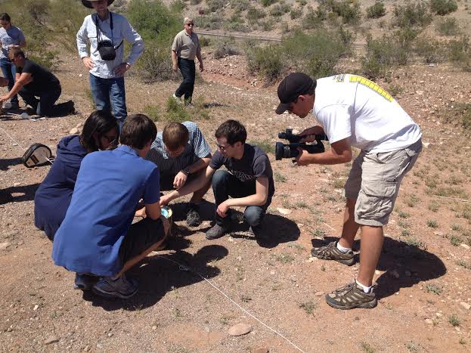
Pictures

Slide 23
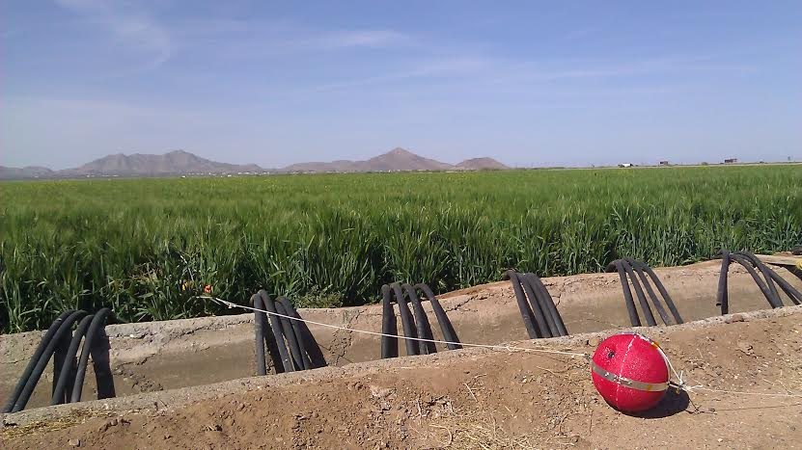
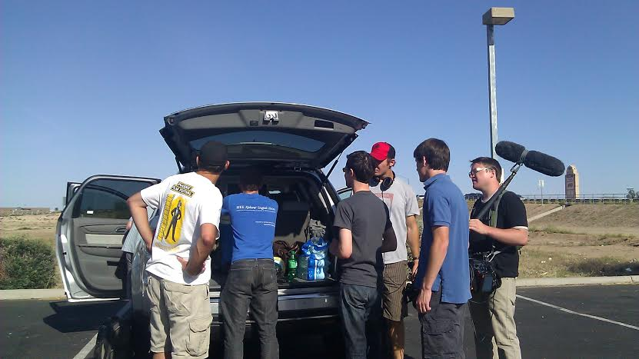
Pictures

Slide 24
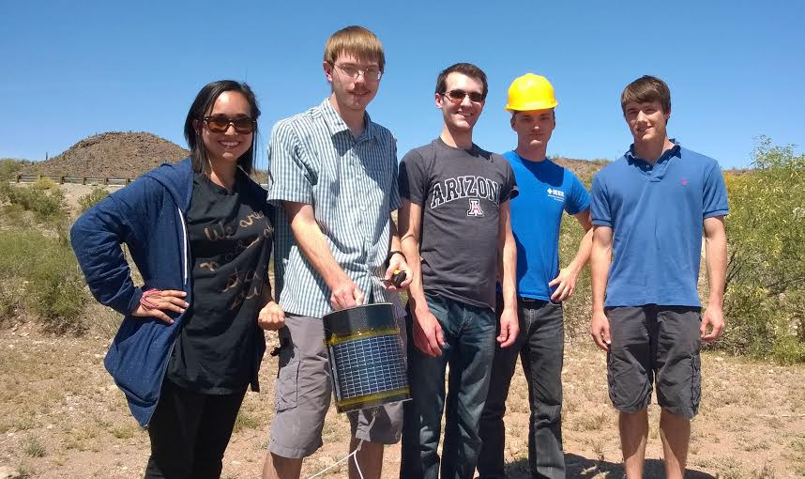
Thank you!

Slide 25
Flight Information
Fall 2013
Date: November 23
Peak Altitude: 86,349 feet
Time of Launch: 9AM
Payload Weight: ? lb
Balloon/Fill Gas:? gm/H2
Ascent Rate: ? ft/min
Distance Flown: ? mi
Spring 2014
Date: March 29
Peak Altitude: 73,794 feet
Time of Launch: 1PM
Payload Weight: 24 lb
Balloon/Fill Gas: 3000 gm/H2
Ascent Rate: 1635 ft/min
Distance Flown: 37 mi

